Slide 1

Practice Management
Developed Collaboratively with
Population Health Improvement Partners
November 21, 2017
Notes:
This presentation was developed as a collaborative project between DPH and Population Improvement Partners.

Slide 2
Training Objectives
Describe Practice Management (PM) and steps for implementation.
Provide context for the assessment, tools and improvement planning
Describe productivity benchmarks and staffing models.
Review Return on Investment (ROI) as a Measurement of Success
Provide an opportunity for questions and feedback
Notes:
We hope you will come away with an understanding of PM and how to get started.
We want you to understand the context in which PM works.
We want to show how increasing efficiency and lowering costs will result in sustainable service.

Slide 3
Background
PM work grew out of:
  Division of Public Health’s (DPH) need to standardize clinic efficiency tools and processes
  Requested by the NC Association of Local Health Directors for established benchmarks for clinic productivity
Notes:
PM work grew out of a DPH consultants’ need to standardize clinic efficiency tools & processes & the request from NCALHD for established benchmarks for clinic productivity & staffing.
This was needed due to:
changes in reimbursement at the federal level;
changes in Medicaid costs settlement, changes in

Slide 4

Practice Management Workgroup Recommendations
Establish Clinical Services Manager position or a Practice Management Team to cohesively manage clinical services
  Joint objectives & decision making
  Joint communication with staff
Team members:
  Finance
  Nursing/clinical manager
  ADM Support manager
Notes:
The PM workgroup recognized the need to:
Have a Clinical Services Manager or Team so that change and improvements can be planned and achieved.
Some agencies decided to have one lead, the Clinical Services Manager while others chose a team to perform this function.

Slide 5
Practice Management Workgroup Recommendations
Develop clear objectives for change:
long term and interim - SMART objectives
Develop a local data dashboard to monitor progress and guide decision making
Train clinical management team in
data analysis and joint decision making
Designate a Quality Improvement (QI) lead for change initiatives
Notes:
The PM workgroup also identified the need for:
SMART goals to guide our work – to make it measurable and to legitimacy
Data collections tools that are user friendly
Establish change communication channels that support staff and PM work.
Remember: we discussed this in the QI segment.

Slide 6
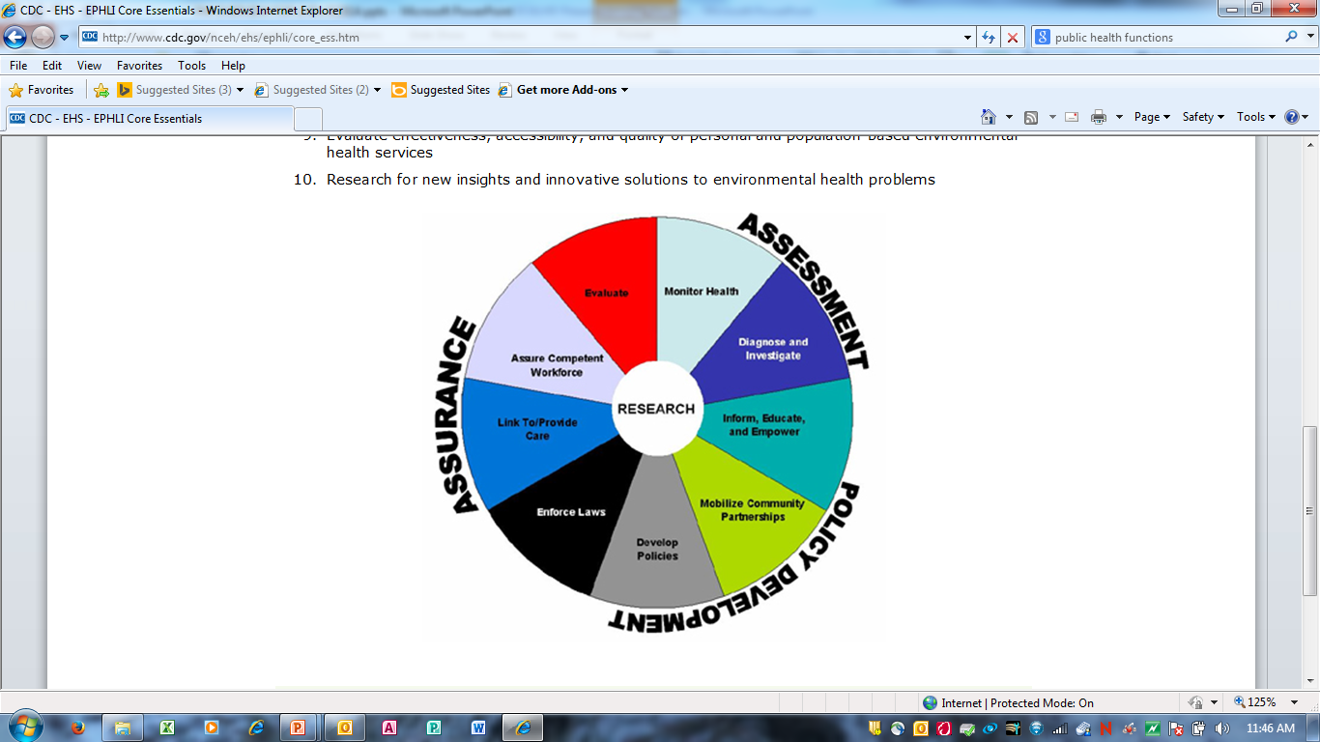
Why is PM work important?
As one of the ten essential services,
the role of public health
is to improve health
outcomes in our
communities.
Clinical Services
Notes:
Clinical services is only a part of public health mission. The ultimate goal is to improve population health.

Slide 7
Model for Improvement
What are we trying to accomplish?
(AIM)
How will we know that
changes are an improvement?
(MEASURES)
Act
Plan
Study
Do
What changes can we
make that will result in
an improvement?
(IDEAS)
Test Ideas & Changes with Cycles for Learning and Improvement
Notes:
7
7
This is a framework to apply improvement principles and is review from the QI presentation.
It is a systemic framework that helps us walk through the steps and
Supports change based on assessment, data, and trials of learning.

Slide 8
Tests of Change
Learning
Changes that result in
improvement
Learning
P D
S A
P D
S A
P D
S A
Ideas
PM work requires ongoing monitoring and change
8
Notes:
This slide shows that as you conduct PDSAs, you will continually improve your process, moving you closer to the goal of continually improving your systems.

Slide 9
How will we know that changes result in improvement?
Why we Measure?
Make data driven, informed decisions
Monitor progress toward goal(s)
Monitor sustainability
What we Measure?
Goods and Services, specifically….
Notes:
Why do we need to measure? Because we if we cannot measure it, we cannot improve it.
What do we measure?
What is the meaning of goods and services?
Goods are items that are tangible, such as books, pens, salt, shoes, hats and folders (or in NC LHDs, “goods” are tools, equipment, supplies, etc.) and Services are activities provided by other people, such as doctors, lawn care workers, dentists, barbers, waiters, or online servers.
Goods and services - Wikipedia
https://en.wikipedia.org/wiki/Goods_and_services
How do we know change is an improvement? Because data collected (measured) will tell the story of whether we have an improved process or not.
So lets look at the specific items we measure in PM (Segway to next slide)

Slide 10
What do we measure?
Budgeted vs. actual revenue
Revenue compared to costs
Payer source by program
Productivity benchmarks: capacity vs. actual
Demand for services by program
No show rate by program
Notes:
What kinds of things to we measure?
Revenue – what we plan for VS what we make
Who is paying the bills, Medicaid, 3rd party payers, self-pay patients
Is out demand and supply balanced
Are we able to “sell” all of the services we have planned for, if not, is it within our control to affect or not. Can we change hours of operation and use our capacity OR decrease wait time to better meet our clients needs OR is it all patient dependent?

Slide 11
Steps in Determining if a
PM Project is Needed
Decide if you have a problem
Complete the Readiness Assessment
Analyze data
Select a problem for improvement
Select QI/PM team
Write a problem statement.
AIM Statement
Test and implement corrective strategies.
Notes:
Now that we have briefly discussed the framework in which improvement happens and indicators (measures) that help us to know when we need to act, lets talk about how we determine if we need a PM project.
Decide if you have a problem – look at the data
Complete the Readiness Assessment – found on the DPH website and contains guided questions to help you decide if you are ready. Ex: during accreditation is not the time to conduct a PM project
Analyze data – Complete tools such as the financial and clinical data workbook and develop some observational statements about what it means. We will look at these tools in more detail later on in the day.
Select a problem for improvement – select something that you know you can accomplish
Select QI/PM team – all agencies need to do this.
Write a problem statement. – What is the problem you are trying to imporve.
AIM Statement – A detailed picture of the who, what, when, how, and why.
Test and implement corrective strategies – your PDSAs
Lets look at each step.

Slide 12
Step 1
Decide if you have a problem – review indicators related to:
  No show rates
  Utilization of staff
  Financial indicators
  Access and availability of services – appointment schedules
  Feedback from internal/external customers
Note: The first 3 bullets are key indicators for every agency.
Notes:
If you know the first 3 bullets about your program, you will be a long way down the road to improvement.
No show rates – tells us how close to using our capacity and are indicators or problems within our processes that need improving.
Utilization of staff – tells us how well we are utilizing our staff time and skills
Financial indicators – Can we pay the bills and keep our doors open
Access and availability of services – appointment schedules – do our appointment schedules support our policies, procedures and processes
Feedback from internal/external customers – if you lower your costs but cause your staff to be miserable in the process, you have missed your target. Need to know what your internal (staff) and external (patients) need and want otherwise, you will not meet PM goals.

Slide 13
Demand vs Supply or Capacity
Calculate Capacity
Based on productivity benchmarks: MD/NP/PA = 4800 visits/year
Calculate Demand
Appointment requests for specific services
Compare Demand to Capacity
Are services aligned with demand?
Notes:
Let’s pause and talk about a key measure, the demand for our services. So how does demand affect supply or capacity?
In our PH Consensus Model developed to help us look at capacity and costs, we defined provider capacity to be 4800 visits/year/provider based on averaging 20 patients/day for 1 FT provider. (This was based on: LHD and DPH input, state level data and national standards and guidelines.)
We measure demand using a tool that captures data related to the number of requests for each service the agency offers over time. We then compared the demand to the capacity for those services. Some services had more demand than capacity while other services had more capacity than demand. We used this information to help us to know where we might redeploy resources to best meet PH needs.
We will talk more about the PH Consensus Model later on in the presentation.

Slide 14
Increase Demand
Market services to public and partners
Implement revenue producing services:
  Postpartum newborn home visits
  MH skilled nurse home visits
  Diabetes education
Market use of resources to improve community health
  Obesity reduction
  Reduce asthma ED visits & hospitalizations
Notes:
How do we increase demand?
Services such as PP or NB home visiting help us connect back in our community by giving us a perspective of who is in the family and community.
There is a more intense focus on community based preventive services as a means to off-site the health burden. If we can implement asthma prevention kits distributed through ER and other community based organizations, we reduce ER visits. Remember an ER visit related to asthma is a 99213 or 99214 which costs about $800.00 vs $150.00 in a LHD.

Slide 15
Reduce Supply
Redeploy resources
  New services
  Community health
Freeze positions/hold vacancies
Consider contracting positions through the Alliance
Cost share resources/staff with other agencies
Notes:
How do we reduce supply?
Remind participants that this work IS NOT about reduction in forces.

Slide 16
Redeploying Resources
In-house
Services
(Individual Health)
Redeployed
to
Community
(Population Health)
Notes:
Remind participants AGAIN that this work IS NOT about reduction in forces. This picture is about the fact the shutter nor the barn door was thrown away (RIFed).
Process what you hear and match against out PM experiences.

Slide 17
Ways to Redeploy Resources
Get into a group with representation from multiple disciplines
Think about your agency and how work is done.
Are there areas where you know that you have too much demand and not enough supply OR staff are performing tasks that could be done cheaper.
Working as a group, identify how you might make changes by redeploying that staff or task to others with the goal of decreasing costs and improving efficiency.
Select a group member to record ideas. (At least 2 Strategies)
Select someone to report your work.
Notes:
Process what you hear and match against out PM experiences.

Slide 18
No Show Calculation Sheet
Clinic Name | Clinic Cancelled | Patient Cancelled | Rescheduled | Missed | Kept | Total | Clinic Name | No Show % | Kept Rate
 |  |  |  |  |  | - | 0 | 100% | 0%
 |  |  |  |  |  | - | 0 | 100% | 0%
 |  |  |  |  |  | - | 0 | 100% | 0%
 |  |  |  |  |  | - | 0 | 100% | 0%
 |  |  |  |  |  | - | 0 | 100% | 0%
 |  |  |  |  |  | - | 0 | 100% | 0%
 |  |  |  |  |  | - | 0 | 100% | 0%
 |  |  |  |  |  | - | 0 | 100% | 0%
 |  |  |  |  |  | - | 0 | 100% | 0%
 |  |  |  |  |  | - | 0 | 100% | 0%
TOTALS | - | - | - | - | - | -
Notes:
Lets talk more about no show data.
This is a calculation worksheet from the Clinical Services Data Workbook located on the DPH website. Some EHRs capture this for you.

Slide 19
No Show Rate Report
Notes:
This is data from a sample county health department. Following QI principles, which program would you target for improvement first?
Goal of no show rate should not be more than 10%. We will show you why when we look at productivity later on in the slide deck.

Slide 20
Provider Productivity
Provider productivity is impacted by provider efficiency, practice style & preference AND how clinical services are organized:
  Demand for services
  Best practice flow models
  How services are scheduled
  Staffing skill and licensure
  Clinical space organization
Notes:
Lets look at productivity and what areas impact how productive we are in our work.
In PM work, these bulleted areas can significantly effect productivity if we are not measuring and making improvements if indicated.
Demand for services – if demand is too high (meaning your line speed is faster than you can keep up with – think of double and triple booking) OR too low, (meaning, staff do not have enough work to keep them busy or work occurs sporadically) it can negatively affect productivity.
Best practice flow models – have you analyzed your work flows to assure they a efficient? Do patients sit in a lot of chairs, waiting to be seen? Do you have too many staff members in the process which can result in ducplication?
How services are scheduled – do you have one schedule that multiple providers have to follow or does each provider have their own schedule?
Staffing skill and licensure – Do you fully utilize your staff skill set and licensure?
Clinical space organization – Are your exam rooms and work rooms organized to reduce waste? Each room is configured the same so it makes it easier for staff to know where supplies are located.

Slide 21
Public Health Productivity Benchmarks
Provider: Average 20 visits/day
4,800 visits/year
Nurse Clinic: Average 20 visits/day/RN
4,800 visits/year
CH ERNs: Average 6* WCC exams/day
with clinical support
1,440 visits/year
STD ERNs: 45 min full assessments; visit expectations based on demand
Annual productivity & capacity calculations based on 5 days/week X 48 Weeks
Notes:
The PM Workgroup that we talked about in the beginning of this presentation put together productivity benchmarks for PH.
The national standard MD benchmark is 30 but we are trying to get all PH providers up to 20/day.
Nurse visits based on 15 min appointments not including CH, STD and MH Enhanced Role duties.
Wake ERNs see 10/day with lead time of 60 minutes: 8 requires support for measurements, plotting, hearing and vision
STD recommendation from the STD Branch--# adjusted based on demand and other available providers AND their experience.

Slide 22
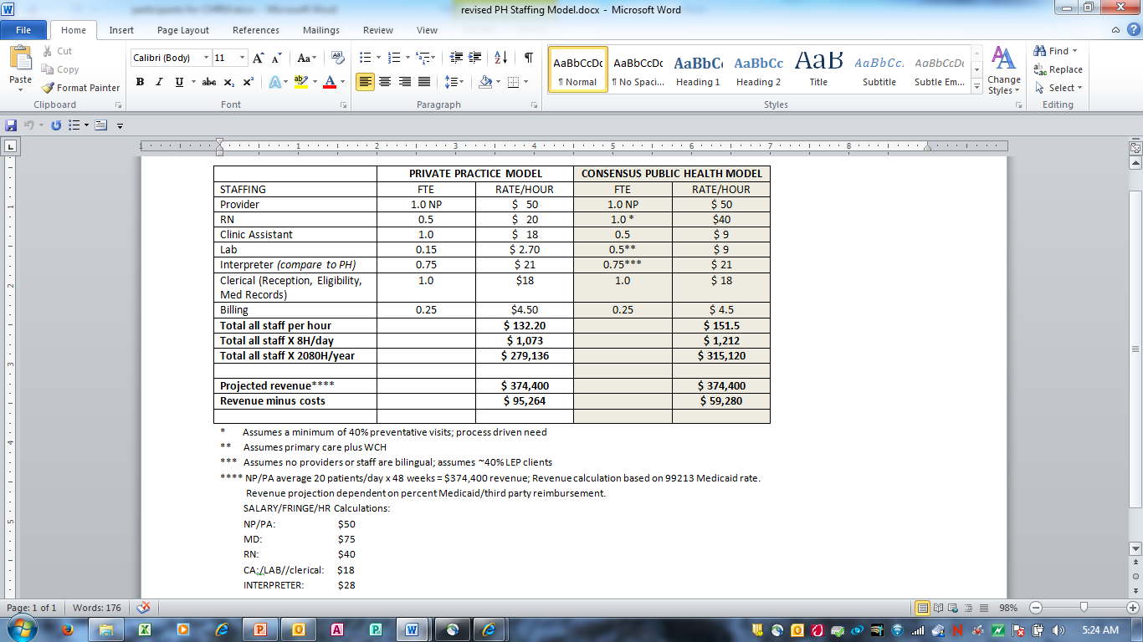
Public Health Staffing Model
At avg 20 visits/day cost per visit = $65.65
Based on 4,800 visits/YR x CPT 99213 ($78)
Based on 4,800 visits/YR x CPT 99213 ($78)
Note: projected revenue based on
100% reimbursement for services
Notes:
Assumes 40% LEP and 40% preventive visits
Model has been trialed in multiple agencies and many of the LHDs that have completed PM projects have reached the 20/day target.
This model allows for breakeven and a little profit
Private practice providers must bill 3X their salary to support their cost and generate revenue
Revenue projection based on 99213 across the board—actual in each agency may be more or less, may be less if % Medicaid is less

Slide 23
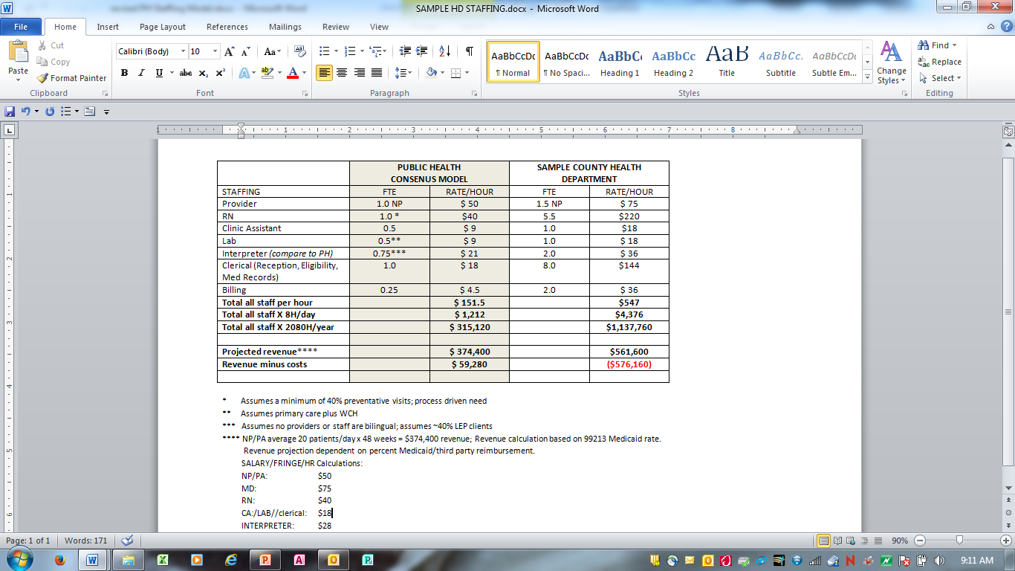
The bottom line for SCHD
Cost per visit at benchmark productivity: $158
$1,137,760 divided by 7,200 visits (1.5 FTE)
Cost per visit at 50% productivity: $316
$1,137,760 divided by 7,200 visits (1.5 FTE)
Projected revenue minus cost at benchmark: (-$576,160)
$1,137,760 minus benchmark projected revenue $562,600 = (-$576,160)
37% Medicaid revenue minus cost = (-$929, 968)
37% of projected revenue $561,600 = $207,792 subtracted from staffing costs $1,137,760 =
(-$929,968)
minus

Slide 24
Summary
What did you learn from review of provider and staff productivity data and the impact on cost of care?
What questions do you have regarding the staffing model or benchmarks?
Current Context
Impetus for Change
Change Ideas
Notes:
Ask the questions and process answers.

Slide 25
Step 2
Complete the Readiness Assessment which requires completion of:
http://publichealth.nc.gov/lhd/
Readiness Assessment
Practice Management Financial Workbook
Practice Management Clinical Workbook
Notes:
The readiness assessment will help you decide if you are ready to begin a PM project.
The workbooks contain the measures we reviewed in QI and also here in PM.
Show participants where these are located.

Slide 26
Step 2 Continued
Additional tools that may need to be completed include:
http://publichealth.nc.gov/lhd/
Demand Tracking Log
GEMBA/Waste Walk
Patient Flow Analysis Data Collection Tool
(Time Study)
Notes:
Show on the DPH website, these tools and refer them to their handouts.

Slide 27
Step 3
Analyzing Data may include review of:
Financial and Clinical Workbook Reports
Observational Analysis
Client/Staff Surveys
Notes:
Remind staff that collecting data without analysis is a waste. Equate it to cashing out your register at the end of the day to measure how you did and what you will need to do if you suffered a loss.
Remind staff these data will impact your Return on Investment that will be covered at the end of the presentation.

Slide 28
Step 4
Select a problem for improvement with potential for quick return and address internally.
    Low Hanging Fruit
    Quick Fixes
    Early Successes
Notes:
We talked about the need to and reasoning behind selecting your first fee projects that are easy, low hanging fruit because IT IS VERY important to have a SUCESS.
What things could your do that do not require a lot of time? (listen for simple tweeks to appointment schedules, co-locating staff or supplies for easier access) Use Bladen as an example.

Slide 29
Example of Low Fruit
Notes:
WIC was in the Red Section, Zone 3 room 100 which consisted of one office with a partition and a 10 foot wide waiting area. We moved WIC to Zone 7, providing a separate office for WIC staff and Rooms 112 and 114 housed the supervisors of services. They had immediate access to staff and clients, with direct line of sight supervision.
We conducted a walk-through and determined that staff were not co-located and/or were too spread out (had too many steps to walk). Also, there was not direct line of sight supervision needed to efficiently supervise services and staff.
Thanks to Bladen County for allowing us to use this slide.

Slide 30
Step 5
Select QI/PM team - who to consider:
Director/Manager – who has the ability to leverage funds and sends change communication message.
Clinical Leadership
Administrative or Management Support Leadership
Fiscal Leadership
Technical Expertise – front line people involved in the process
Notes:
Point out the need to have at least one of these types of disciplines on the team. Example: DON and Administrative Supervisor work in a symbiotic relationship.
Remind them of the following – from QI.
Directors = point the managers towards the vision and mission of the agency and leverages the funds to make it happen
Managers = plan for, design and control factors that affect work
Supervisors = over see or direct people at work
Line of Sight Supervision
Standardize

Slide 31
Step 6
Write a problem statement:
  A problem statement is a brief description of the issues that need to be addressed by a problem solving team and should be presented to them (or created by them) before they try to solve a problem. Select one problem at a time based on agency priority or ability to succeed. (Adapted from Wikipedia)
Notes:
Examples:
“Child Health revenue is decreasing.”
“Patients are complaining about long wait times before being seen.”

Slide 32
Step 7
Aim Statement:
If you can answer what, for whom, by when, by how much, then you have an
Aim Statement.
http://publichealth.nc.gov/lhd/
Notes:
http://publichealth.nc.gov/lhd/
Handout refer participants to the Aim statement template and explanation. AND, the fact we reviewed this over in QI.

Slide 33

Aim Statement Template

Slide 34
Step 8
LHDs tests and implements corrective strategies by:
Testing:
  PDSA
  Kaizen
Implementation and Adoption of Corrective Measures
  Policy, Procedures
  Training
  Standardizing Processes
  Ongoing Measuring – Return on Investment
Story Board – tell the story
  Orange County California – STD Story Board

Slide 35
Ongoing Measuring
Measure
Measure
Measure

Slide 36
Why should we continue to monitor?
Increase Efficiency
Decrease Costs
Notes:
We want to increase efficiency and decrease costs using QI strategies to achieve quality services (satisfied employees/patients/citizens AND quality services provided while containing costs).
This is a continuous process
Remember the three indicators but there may be other indicators you need to monitor:
No show rates
Payer Source - Who is paying the bill
Productivity by provider - How many patients do each staff member see.

Slide 37
Practice Management
Ongoing monitoring of trends in productivity and revenue and data-based response
  Joint performance objectives and data dashboards provide structure and information to identify issues and make appropriate improvement decisions
Notes:
One way to assure joint performance objectives is to put it into staff performance appraisals or work plans (remind staff this was covered in Management segment presented inApril).
Examples:
You will process 100 Medicaid claims/week
You will average 20 patient per day.
You will make 20 home visits/week.

Slide 38
Practice Management
Improvement opportunities:
  Strategies to optimize revenue:
    Billing & coding audit → training & monitoring of practice’s coding
    Maintain current billing & follow-up of denials
    Accept credit & debit cards
    Expand payer panels
Notes:
Are you performing coding and billing audits? Tools on DPH webiste
Are you current with your denials?
Do you accept credit cards?
How large is your payer panel? Expanding your payer panels provides market safety. You have multiple payers feeding your bottom line. Remember: private payers pay for things that Medicaid does not pay for.

Slide 39
What is Return on Investment (ROI)?
Bottom Line = Revenue - Costs
Costs
Revenue
Notes:
Ask participants to share their thoughts on ROI?
How many LHDs do ROI process before and after implementing a service?
Cost Benefit Analysis?

Slide 40
ROI/EI – Why do it?
Earns the respect of Stakeholders and Leaders
  Justification for implementing an intervention/project
View public health as an investment vs. expense
  Helps to “sell” the concept of public health
Part of evaluation…accurate, credible, and widely used process
  Based on facts or evidence so it’s believable
40
Notes:
Industrial Extension Service www.ies.ncsu.edu
40
Why is ROI important? Why should we care?
decreasing budgets and programs – ROI earns the respect of Sr. Mgmt. to see impact and $ value of project; good way to display success of our project in today’s economic state
Alters perceptions – learning and performing QI is an investment vs solely an expense; justifies our time & energy on project
ultimate level of evaluation – RESULTS based process that brings focus on results (the measurable objectives)
Measures contribution – most accurate, credible, and widely used process, very reputable and widely recog’d in business community
Low probability of implementing EBIs b/c there’s no business case for the monetary benefits that it will reap
The more we can show a positive impact the better chances that EBI will be implemented.
You can use ROI two different ways: You can calculate an ROI to show the impact of your intervention or you can look at an ROI calculated by someone else to determine if your comm wants to implement a given program.

Slide 41
Terminology/Formula
EI (economic impact): Refers to costs and benefits of an activity.
EI = Benefits-Costs
ROI (return on investment): A performance measure used to evaluate the efficiency of an investment
ROI = (Benefits-Costs)/Costs
*
Notes:
Review ROI, EI definitions (EI=Examines the effect of a policy, program, project, activity or event on the economy of a given area.)
2. All come from Finance industry (bus admin and mgmt degrees) used for purchase of eqpmt, acquisition of property or another co. – business decisions, IMPACT TO A BUSINESS, financial impact mostly. There are parallels from this business realm that we can apply to our QI work too.
3. Terms are similar and, right or wrong, sometimes used interchangeably. For our QI work, we’ll refer to it as ROI or EI, even though in the world of Finance there are some differences. Don’t be surprised if someone says “it’s not ROI because ROI is a % or ratio”…we’re using what we need for our purposes.
QUESTIONS???
*

Slide 42
Don’t Forget
Measures need to include enough data elements to assure a complete picture or description of what you are studying.
May include:
Quantitative Data – numeric
  Clinical and Financial Workbooks
  No-show rate data
  Revenue Vs Costs
  Revenue from payer mix
Qualitative Data – non-numeric
  Patient and Staff Satisfaction Surveys
  Community Focus Group Survey Data
Notes:
Acknowledge this is a reminder for participants to make sure they include more than one or two pieces of data.
Quantitative Data
These are things you count numerically.
Qualitative Data
Data of this type are: feelings, opinion, help describe parameters such populations

Slide 43
What do you think?
Will it work in your agency?
If yes, why?
If not, why?
Undecided, why?
Notes:
Now that we are at the end of the day, what do you think?
Ask if the participants if:
It will work, why?
It will NOT work, why?
It may work – go on to ask, “What would it take to make it work?”
They are undecided, what is contributing to their indecision?
Go to the next slide.

Slide 44
Summary
Based on our discussions thus far, how would you assess your clinical services sustainability as currently functioning?
Did the discussion stimulate your interest in improvement activities?
Current Context
Impetus for Change
Change Ideas
Notes:
Ask for assistance to record on flip chart paper.
Given the answers voiced in the previous slide, ask,
What might be your next steps?
Where do you think you might start to implement a PM project in your agency?
What barriers do you think you might encounter?

